Slide 1

Meal-Planner Team

Slide 2





Meal-Planner Team
Malgorzata Zaremba
Joona Rautiainen
Nelli Ukkonen
Dennis Apter
Katri Palmroth

Slide 3



Slide 4

Agenda
Project overview
Demo
Architectural development
Tools used in this project
Cost comparison
Code snippets
Development possibilities
What was learned or improved on

Slide 5

Project overview

Slide 6
Meal Planner
Front-end
Lambda functions
Python
Back-end
Lambda functions
Html
S3
Html
Python
DynamoDB
Jsonish
SNS
String
Notes:
The project consists a separate frontend and backend. The front end consists a static html-based website set up in the s3 bucket and snippets of python/html code created with lambda functions, which can be used to create the dynamic parts of the site

Slide 7

Demo

Slide 8


Slide 9
Architecture

Slide 10









First Architecture
Database for subscriptions
Adding user’s details to SQS
Website
Save to database
Once per week
Recipes to user
Send to SNS

Slide 11
Second Architecture
Once per week
Website
Save subscriptions to SNS
Diets
Recipes for week

Slide 12

Final Architecture
Account Database
Once per week
Create account
Sign-In
Private site to save favorites
Website
Send different diets
Subscription
Email list
Create recipes
AI
Send weekly recipes

Slide 13
Tools

Slide 14
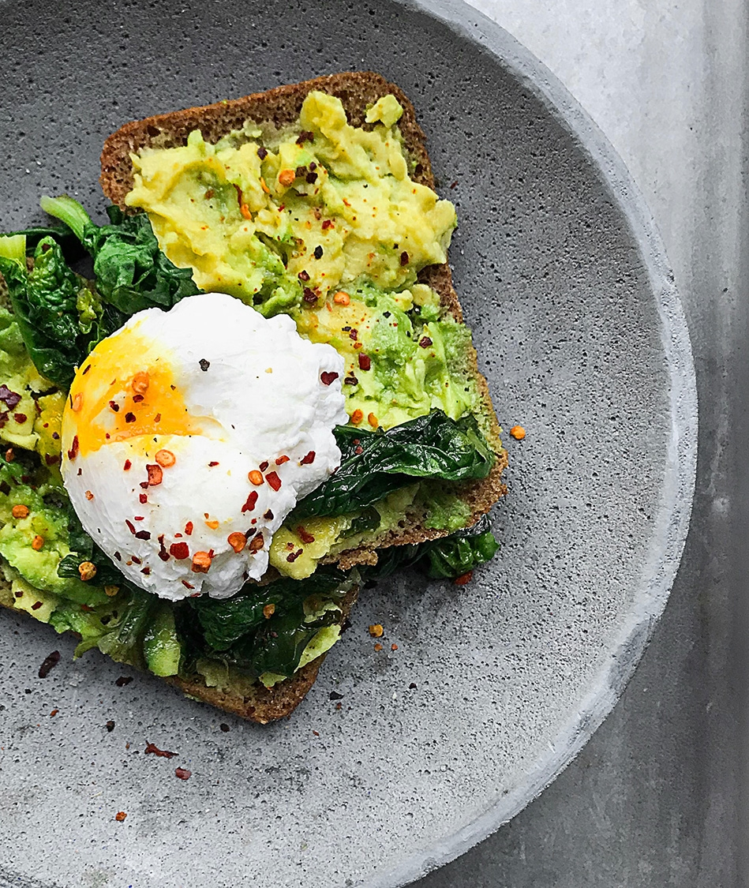










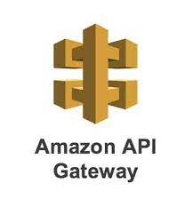







Tools that we used in this project

Slide 15
Hosting

Slide 16




S3 based website
S3
GET/SELECT from s3 bucket price: 0.0004$ per 1000
S3 storage costs: 0.023 per GB per month
Used resources
Can only host static websites, so dynamic parts have to be made with other resources – in our case lambda functions and access tokens (to come)
S3 bucket to host websites
X lambda functions to maintain dynamic functions * Sign in * Sign up * Subscribe * Showcase created random recipes
Api Gateway * Acts as a gateway between our lambda functions and website in this instance
Lambda
0.0000166667 for every GB-second
0.20 $ per 1 M requests
Api gateway
Approximately 1 dollar per million calls

Slide 17
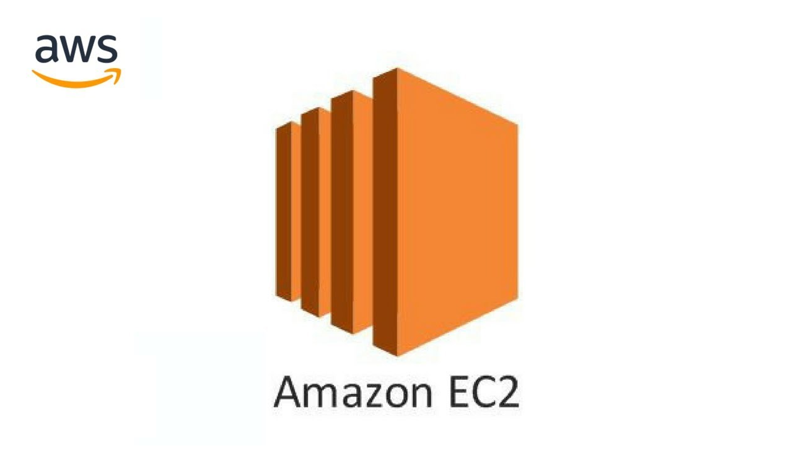
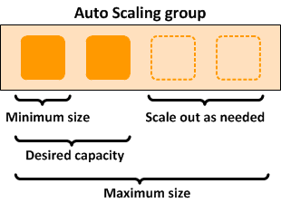

EC2 based website
EC2
on-demand: t3 0.0057 $ per hour = 4.104 per month
reserved: t3 0.003 $ per hour = 2.16 per month
Used resources
Can host the whole website, but needs to be put behind an auto-scale group/ something that ensures the upkeep and scalability
EC2 bucket to host websites
Auto Scaling group to scale our resources
Load Balancer to divide traffic and maintain a united website front for customers
Auto Scaling group
Free
Application Load Balancer
18.144 $ per month 5,76 $ per LCU per month

Slide 18

Comparison
S3 is easier to integrate with other AWS resources, EC2 easier to code yourself
Minimum flat rate for current product
S3:
0,023 $ per month
EC2:
26,064 $ per month
Approximate added price per 1 000 users per month
S3:
1.6 $ per month
EC2:
0 to 10 $ per month for the first 1000, 5 to 10 $ after that

Slide 19

Total monthly budget
First year for free, if using a new AWS account for hosting
Flat rate
S3:
0,023 $ per month
DynamoDB:
1,27 $ per month
Total:
1.293 $ per month
Approximate added price per 1 000 users per month
S3: 0,0004 $ per month
Api Gateway: 1 $ per month
DynamoDB: 0.10583 $ per month
Lambda:
1.4 $ per month
Total: 2,50 $ per month

Slide 20
Code Snippets

Slide 21
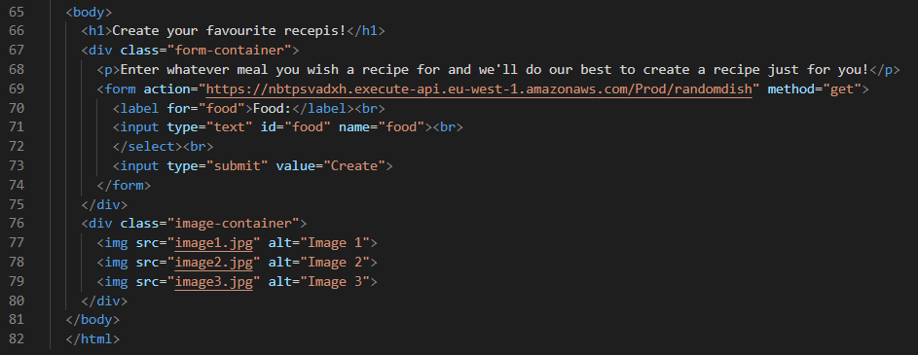
Some Code
Website homepage
Preparation
Add preparation steps
Add a tip or note
Add nutritional information

Slide 22
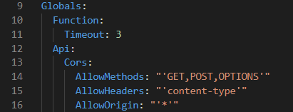
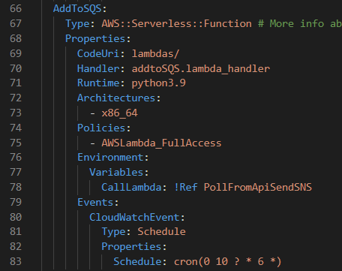
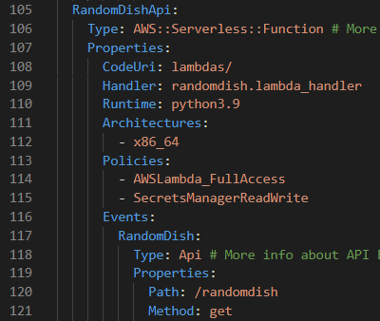
Some more Code
Template

Slide 23
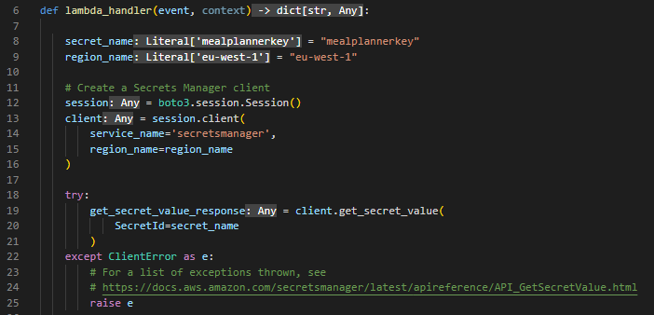
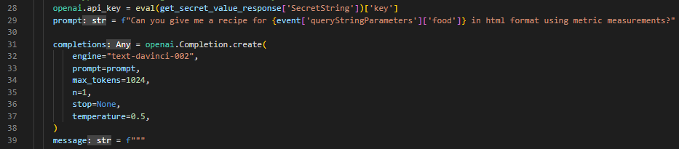
Some more Code
OpenAi usage

Slide 24
Development Possibilities

Slide 25
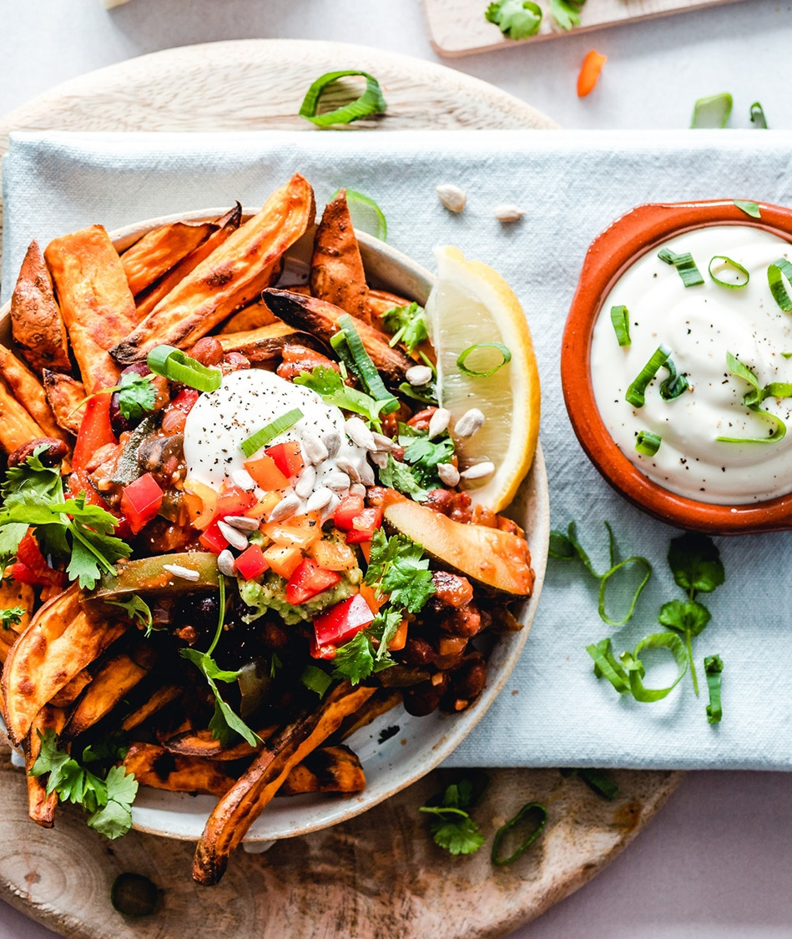
Development possibilities
The shopping list directly to the stores and then the groceries delivered directly to your home
Preselection of recipes and the possibility to influence the future delivery
Selection of the number of food portions
Recipe reviews
Taking allergies into account
More dietary options
Adding your own recipes
Taking into account what food items are already at home
Ads for the website and SNS-message
Using SageMaker for development of new recepies

Slide 26
What (new) was learned or improved on

Slide 27

What (new) was learned or improved on
Lambdas
DynamoDB
API Gateway
SNS
EventBridge
ChatGPT
AI
HTML / CSS
Static website hosting on S3
SAM / Cloudformation
Pipeline
Polly
Password encryption / KMS
Secrets Manager

Slide 28

The Meal Planner Development Team wants to Thank you for your time!

